Slide 1

Water Plant Management System
CDAC ATC NETCOM JAIPUR
GROUP MEMBERS
NAME PRN NO
Dipti Sarwade - 210930920015 [TEAM LEADER]
Tejas ghungarde - 210930920051
Deepak Bhagat - 210930920011
Govind Dudhewar - 210930920017
Payal Magare - 210930920036

Slide 2
Table Of Content
Introduction
Need of project
Modules In Project
Design and Implementation Constraints
Specific Requirement

Slide 3
Introduction
Existing System
The present system is a manual system. Manual system involves paper work in the form of maintaining various files and manuals. Maintaining critical information in the files and manuals is full of risk and a tedious process.

Slide 4
Proposed System
Online web application of Water Plant will provide benefits to customer as well as plant management Customer can use this like E-commerce and plant management can keep track and details of customers.

Slide 5
Need Of Project
Unfortunately sufficient safe portable water is not available everywhere in the country, either harmful chemical substances are found in the layers of earth which enter in to water or it may be contaminated due to pathogenic micro-organisms.
If such water is consumed, the body suffers from water born diseases. Due to this, it has become imperative to process and bottle safe portable water for the mankind in prevailing conditions.

Slide 6
Benefits of Water Plant Management System
This online Water Plant Management System is fully functional and flexible.
Eco-friendly: The monitoring of the water plant management and the overall business becomes easy and includes the least of paper work.

Slide 7
Modules In Project
Admin:
Admin can login to the system.
View the list of Orders.
View the list of products.
View the list of Users.
Manage Orders.
Manage Products.
Manage Customers.
Customer:
Customer can login to the system.
View his/her details.
View Products.
Place Orders.

Slide 8
Operating Environment:
Server Side:
Processor: Intel® Xeon® processor 3500 series
HDD: Minimum 500GB Disk Space
RAM: Minimum 2GB
OS: Windows 8.1, Linux 6
Database: Oracle 11g
Client Side (minimum requirement):
Processor: Intel Dual Core
HDD: Minimum 80GB Disk Space
RAM: Minimum 1GB
OS: Windows 7, Linux

Slide 9
Design and Implementation Constraints:
The application will use Spring Boot, JavaScript, jQuery and css as main web technologies.
Several types of validations make this web application a secured one and SQL Injections can also be prevented.
Since Water plant Management system is a web-based application, internet connection must be established.
The Water Plant Management System will be used on PCs and will function via internet in any web browser.

Slide 10
Specific Requirement:
External Interface Requirements:
User Interfaces:
All the users will see the its dashbord when they enter in this website. This page
asks the users a username and a password.
After being authenticated by correct username and password, user will be
redirect to their corresponding profile where they can do various activities.
Hardware Interfaces:
No extra hardware interfaces are needed The system will use the standard hardware and data communication resources.

Slide 11
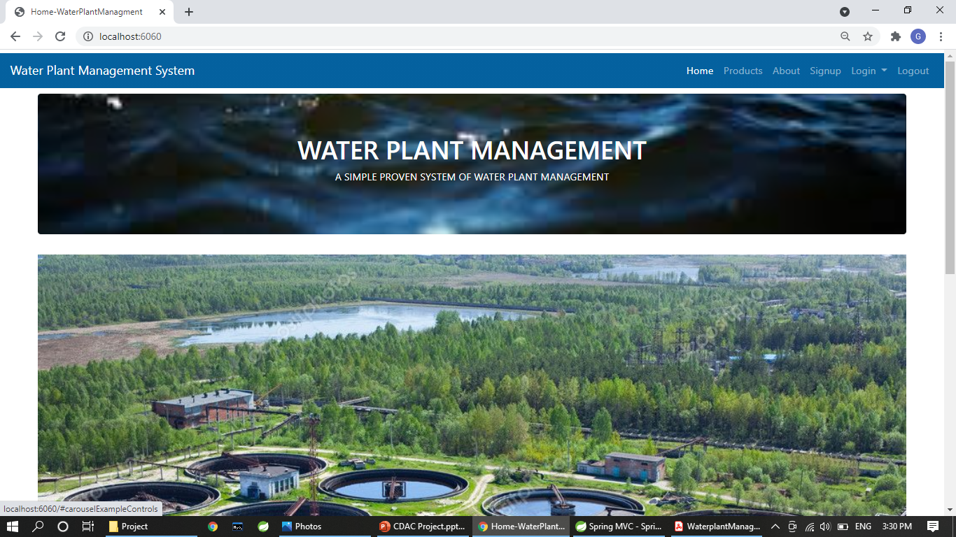
HOME-PAGE

Slide 12
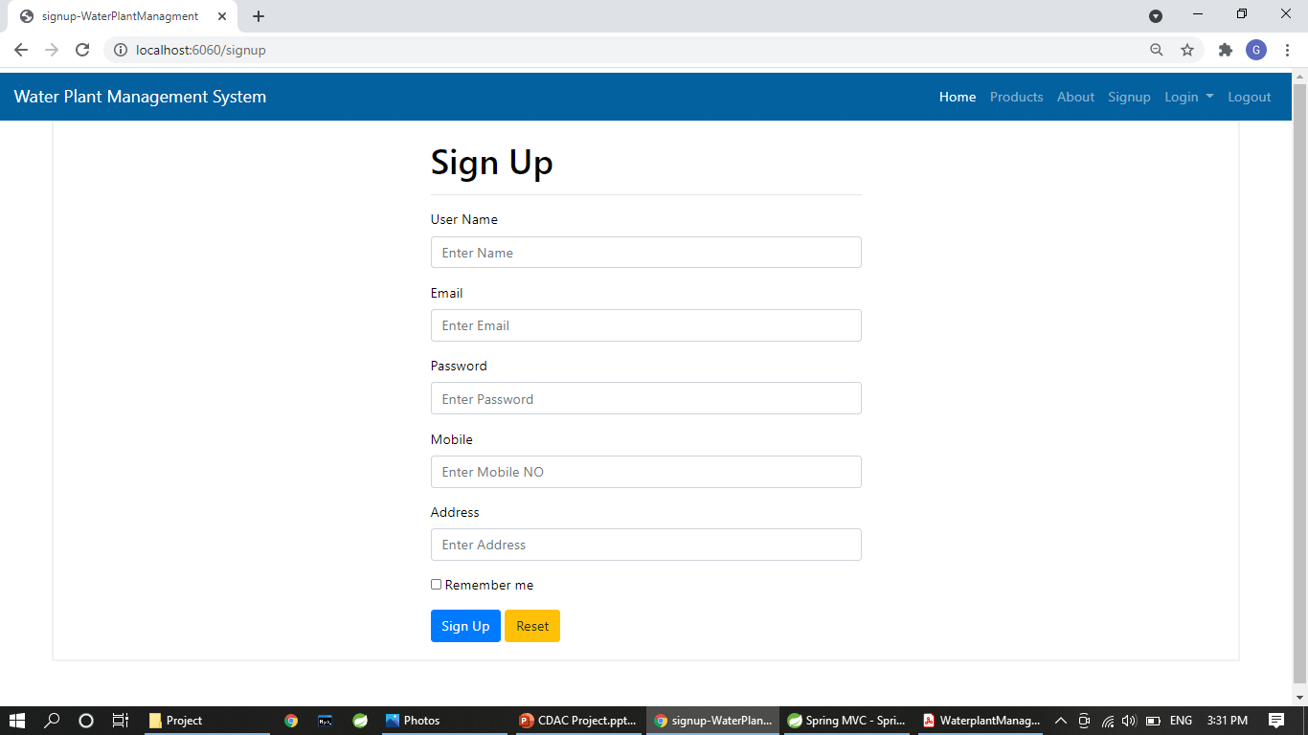
SIGN UP PAGE:

Slide 13
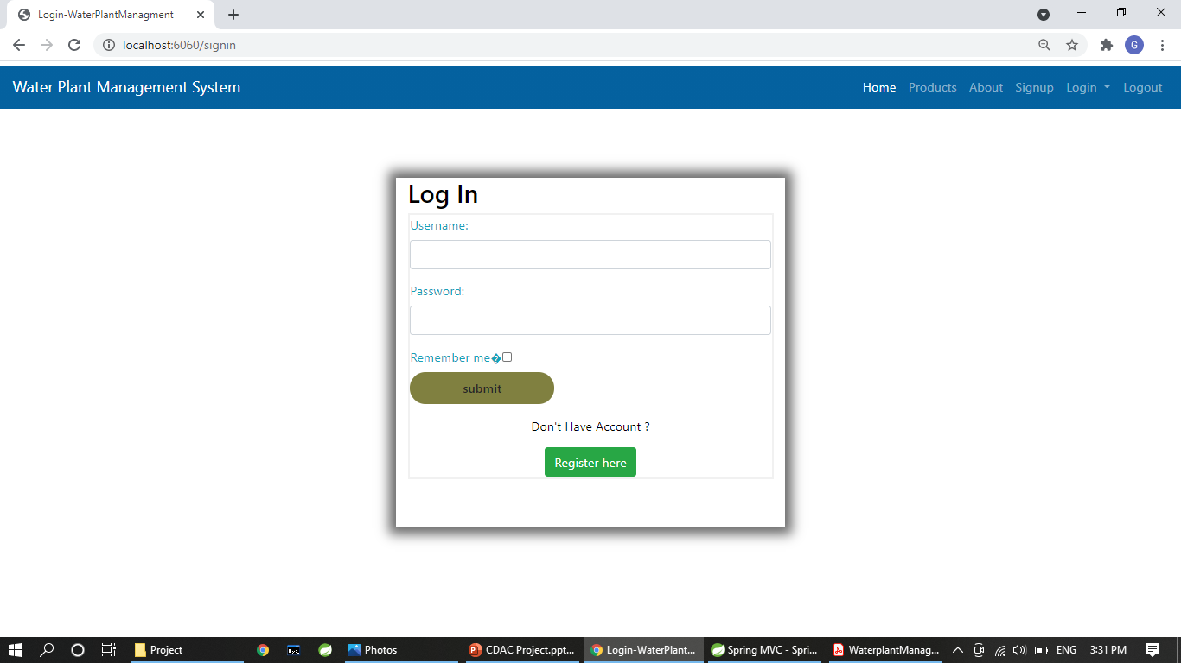
LOG IN PAGE:

Slide 14
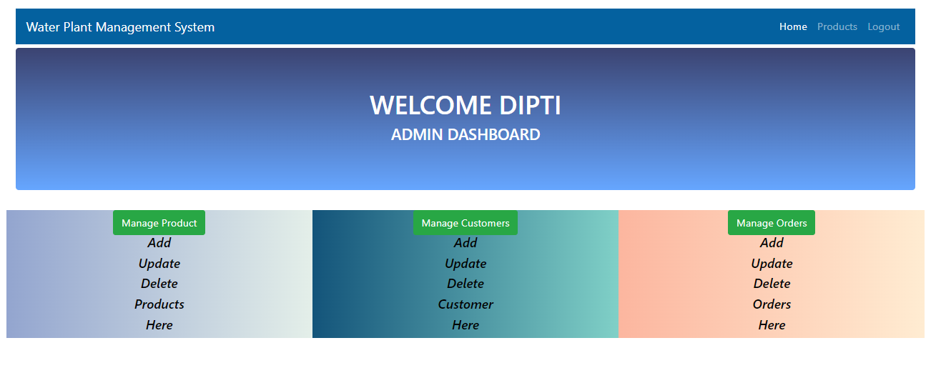
ADMIN DASHBOARD

Slide 15
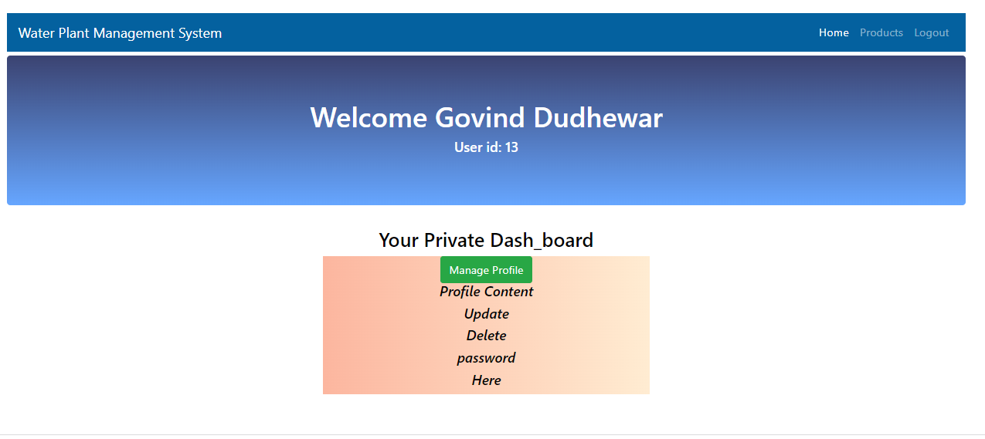
USER DASHBOARD

Slide 16
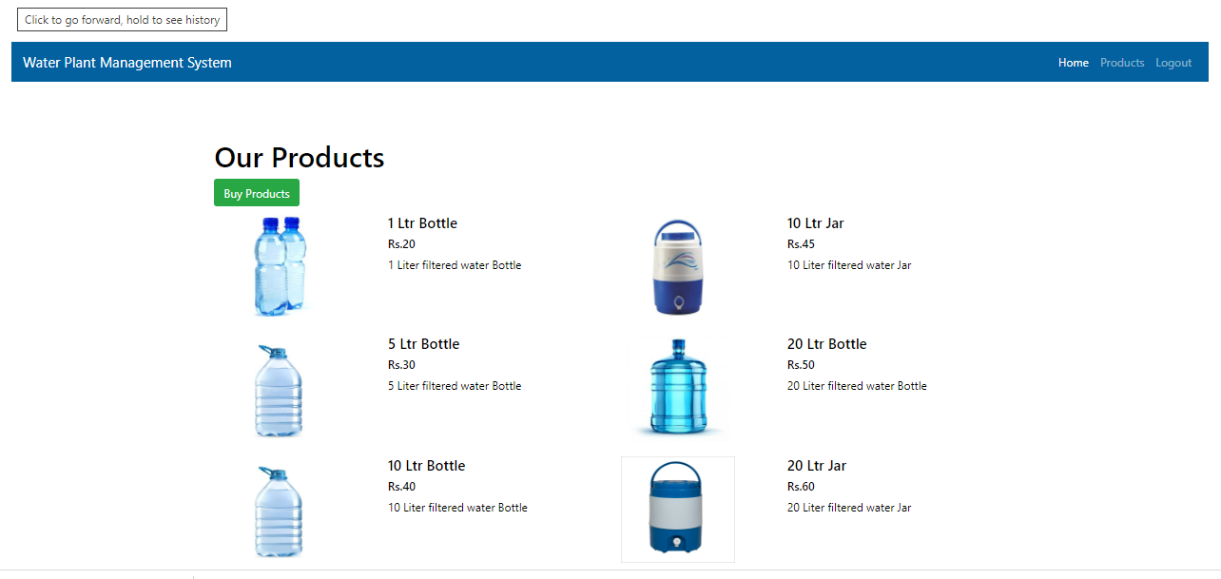
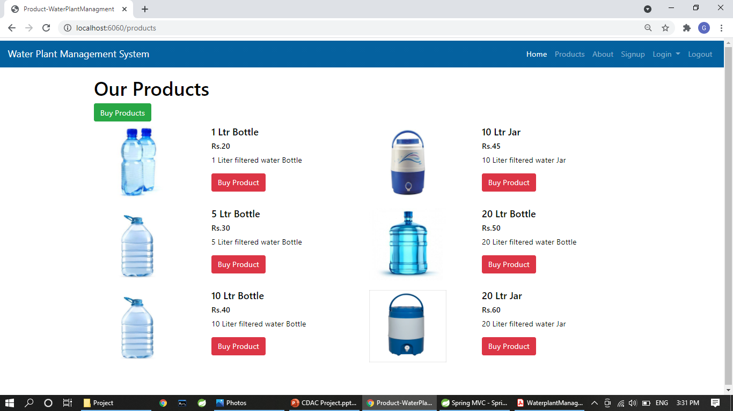
All PRODUCTS:

Slide 17
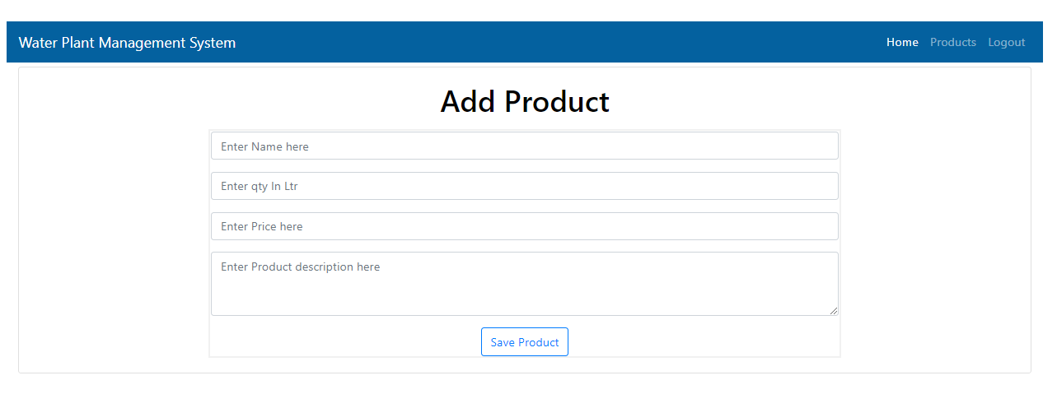
ADD PRODUCTS

Slide 18
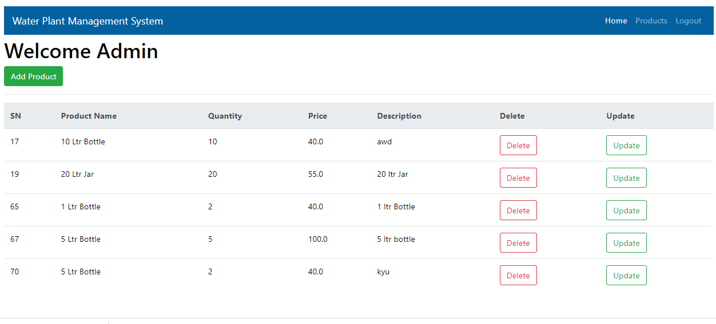
ALL PRODUCT

Slide 19
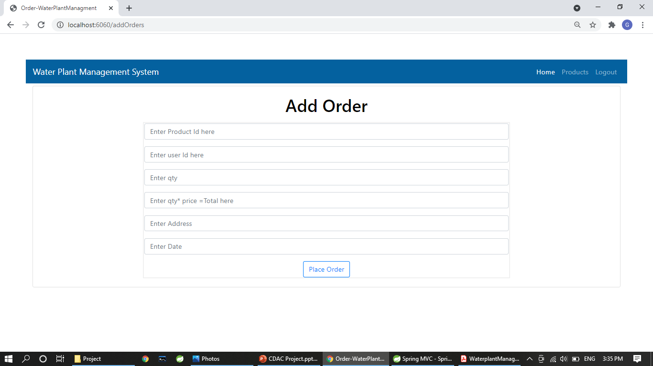
ADD ORDER:

Slide 20
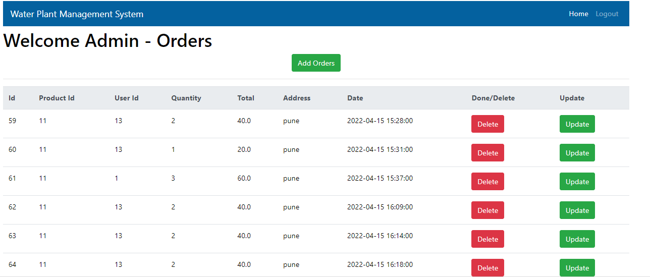
All ORDER:

Slide 21
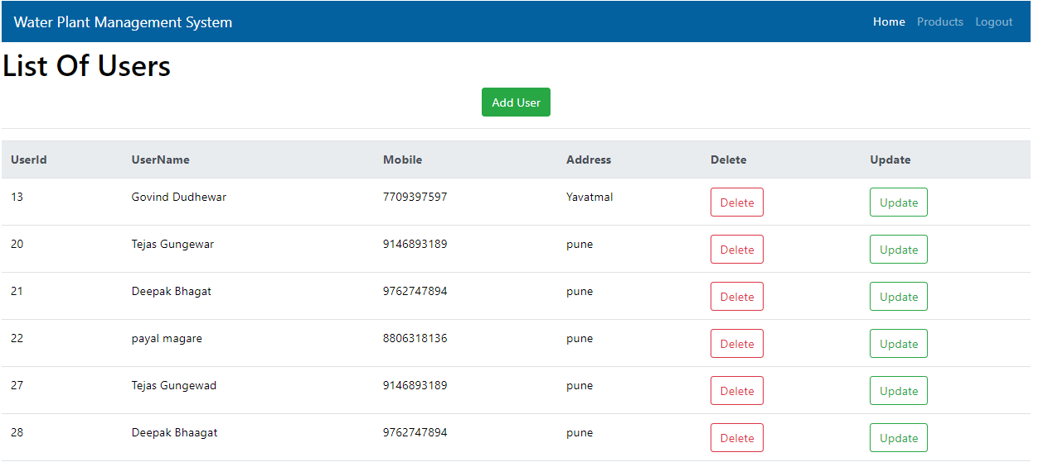
All user:

Slide 22
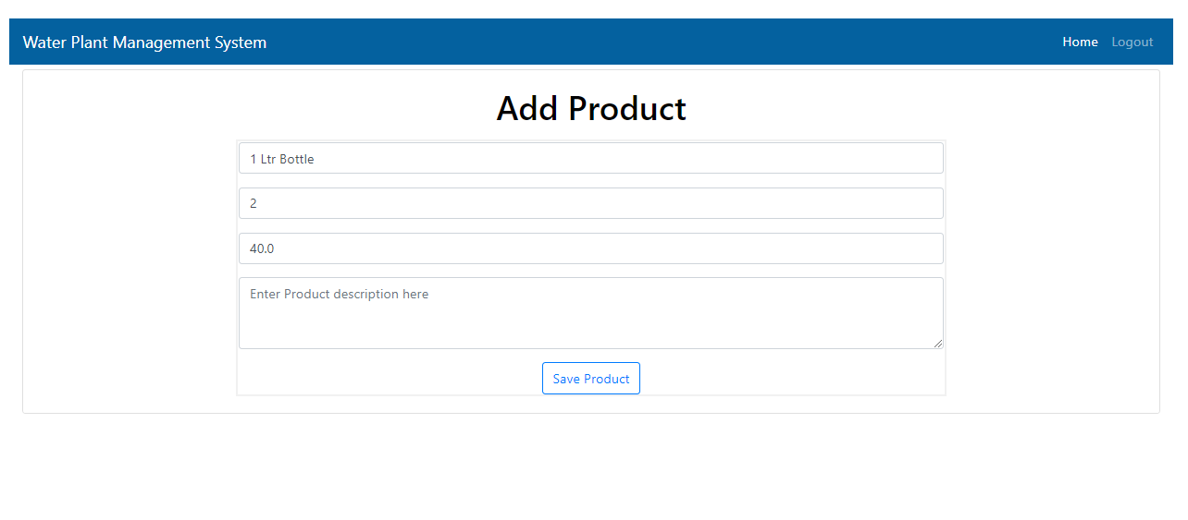
update product:

Slide 23
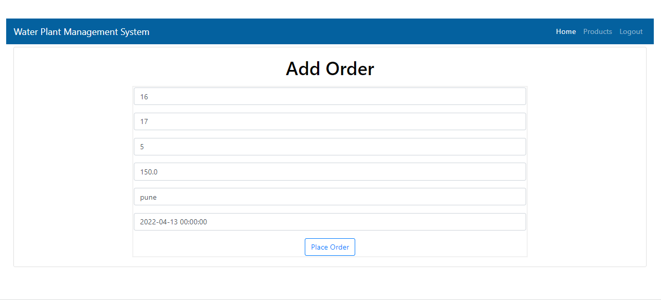
update Order:

Slide 24
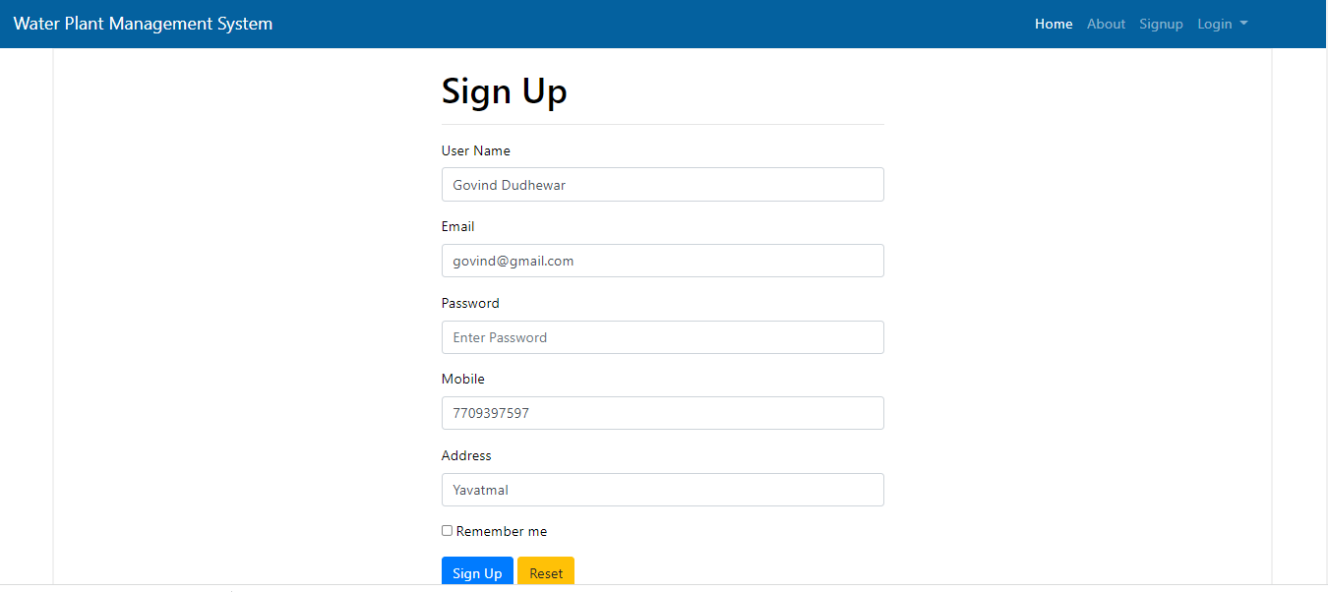
update user:

Slide 25
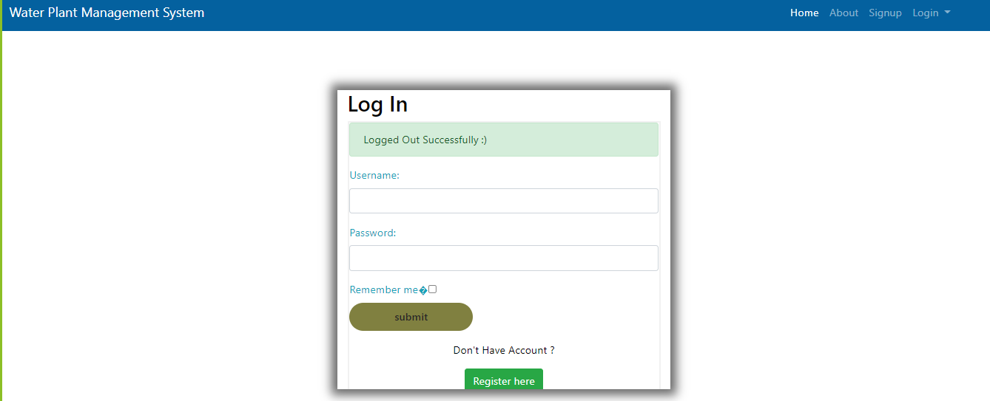
Logout:

Slide 26
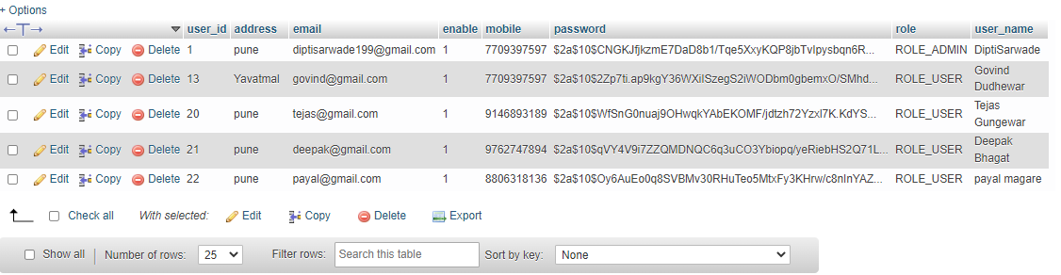
user Table:

Slide 27
Product Table:

Slide 28
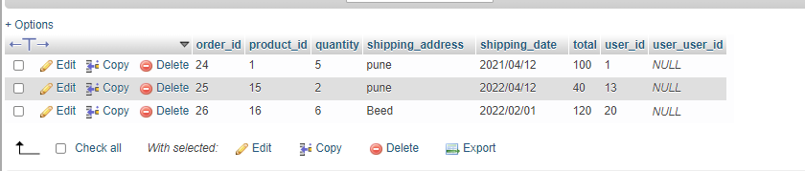
order Table:

Slide 29
Future Scope
This Project can be further extended to supplier role where different supplier can add their products to site.
Online payment and verification facility can be added to user.
Water for industry, hospitals, events in bulk quantity will be provided by water plant .

Slide 30
Conclusion
Water Plant management system puts the actual working of a water plant in traditional way.
Putting water plant at online mode for customers and management is main key feature for project.
Customers can online products and admin can manage orders at ease through this project using this website anywhere and anytime for their own comfort

Slide 31
THANK YOU…!

